Slide 1

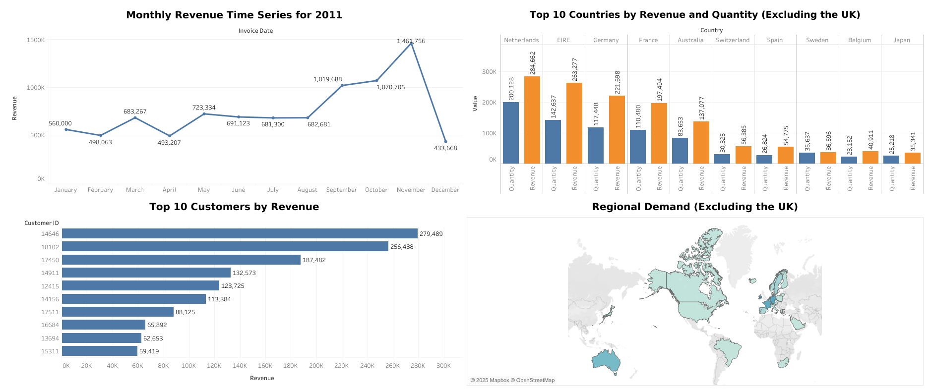

Retail Online Data Analysis and Visual Insights
Analysis and Visualizations for Business Insights
Sasi Rokkam
Notes:
Hi, my name is Sasi Rokkam. I’m excited to share insights from the data analysis I did for our retail online business. This presentation shows key findings and visuals about revenue trends, top-performing regions, and customers to help with better decision-making.
Before we look at the insights, I’d like to mention the steps I took to prepare the data. I made sure the data was accurate by fixing missing values, removing duplicates, and keeping everything in a consistent format. This helped ensure the analysis is reliable and the visuals are clear.

Slide 2
Overview
1
Analyze monthly revenue trends for 2011 to identify seasonal patterns and aid in forecasting.
2
Identify the top 10 countries (excluding the UK) by revenue and quantity sold to assess market performance.
3
Highlight the top 10 customers by revenue to target high-value clients and ensure their satisfaction.
4
Determine regions with the highest product demand (excluding the UK) to prioritize expansion strategies.
Notes:
"To structure this presentation, I’ll address four key questions that cover revenue trends, top-performing countries and customers, and product demand by region. Each analysis is supported by data-driven visualizations."

Slide 3
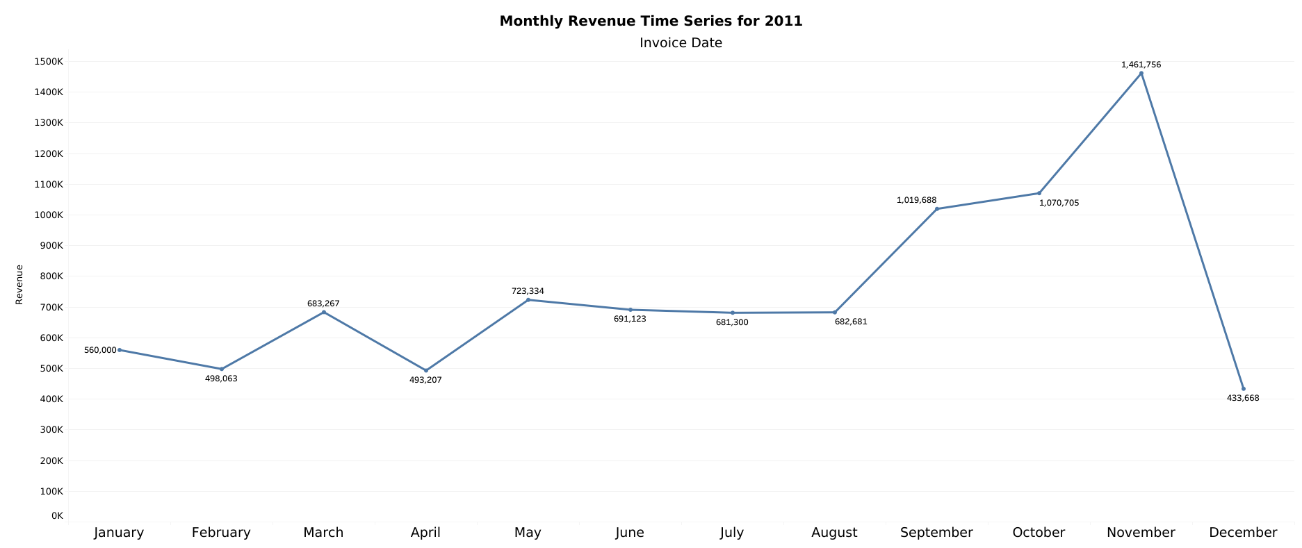
Revenue Trends for 2011 (Question 1)
Sharp Decline
Highest Revenue
Lowest Revenue
Customer ID 14646 generated the highest revenue of $279,489.
November 2011 with $1,461,756, likely driven by holiday shopping and seasonal demand.
April 2011 with $493,207, potentially due to Pre-holiday
Notes:
"The first analysis focuses on the revenue trends for 2011. This line graph shows monthly revenue. We see peaks during September to November, likely due to holiday shopping, and dips during December to April. Understanding these seasonal trends can guide future forecasting

Slide 4
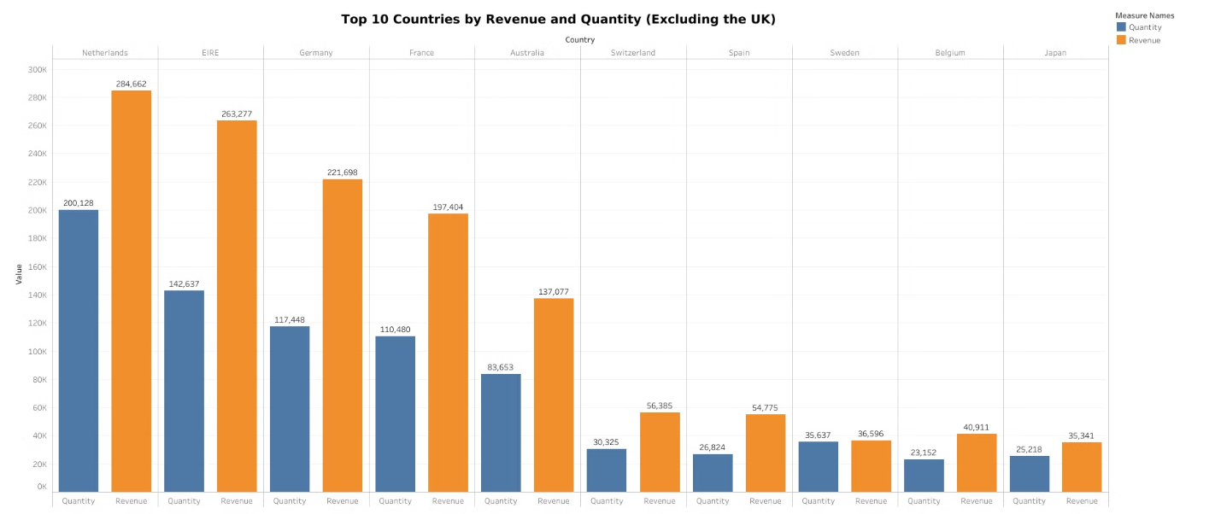
Top 10 Countries by Revenue (Question 2)
Highest Revenue:
Highest Quantity Sold:
Netherlands leads with $284,662.
Netherlands also tops with 200,128 units.
Notes:
"This bar chart highlights the top 10 revenue-generating countries, excluding the United Kingdom. The second visual compares revenue to the quantity sold. We observe that Netherlands leads in revenue, also Netherlands shows higher quantity sold, indicating potential pricing differences or customer behaviors."

Slide 5
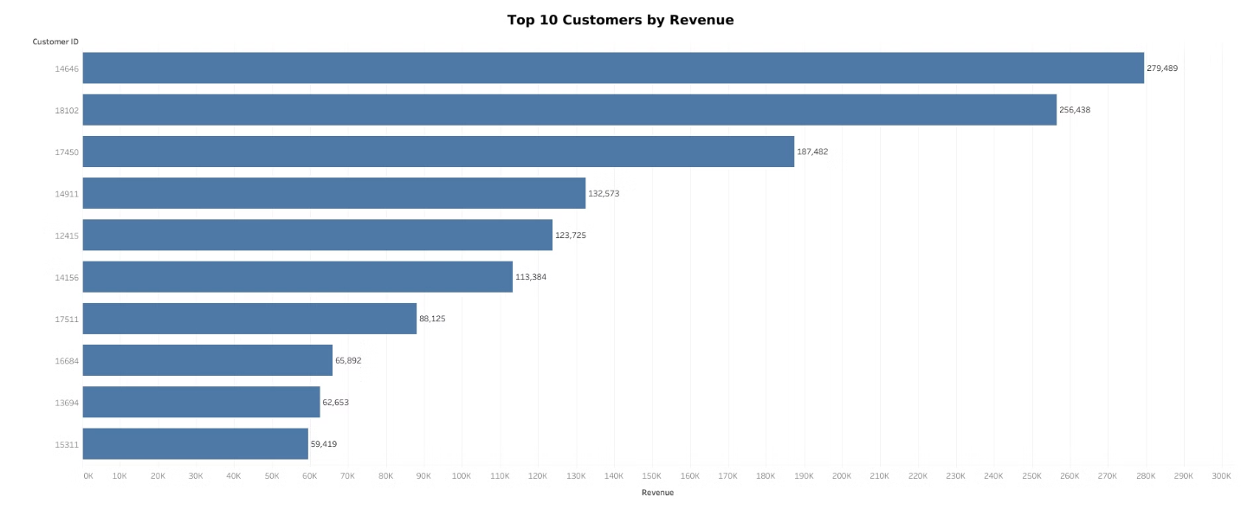
Top 10 Customers by Revenue (Question 3)
Top Customer:
Key Insight:
Customer ID 14646 generated the highest revenue of $279,489.
This customer contributes significantly to total revenue, making them a high-value client.
Notes:
"Here, we see the top 10 customers ranked by revenue. The largest contributor customer ID is 14646 , significantly outperforms others. Focusing on personalized experiences and loyalty programs for these customers could strengthen relationships and sustain revenue growth."

Slide 6
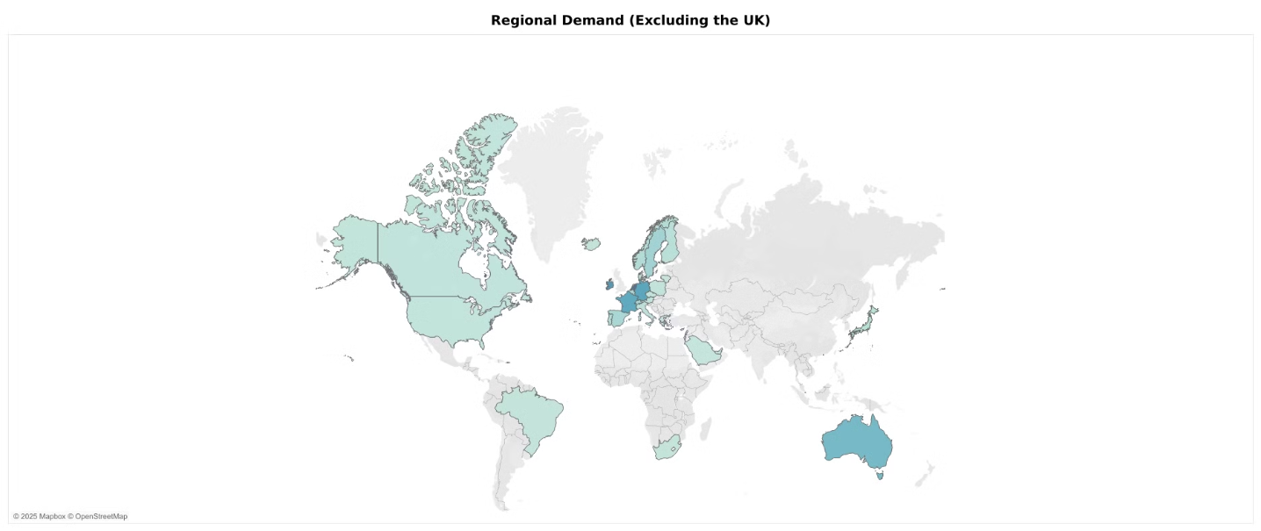
Product Demand by Region (Question 4)
Highest Demand:
Other Key Markets:
Indicates high demand for products in these regions, with the Netherlands being the strongest market.
Netherlands leads with 200,128 units sold.
EIRE (142,637), Germany (117,448), France (110,480), and Australia (83,653).
Notes:
"This map visualizes product demand across all regions, excluding the United Kingdom. High-demand areas like Netherlands and Republic of Ireland indicate opportunities for expansion. This data will help prioritize regions for targeted marketing and operations."

Slide 7
Recommendations
Seasonal trends for targeted promotions.
Top countries for international focus.
Retention strategies for high-value customers.
Expansion opportunities in high-demand regions.
Notes:
In conclusion, I recommend capitalizing on seasonal trends to implement targeted promotions, concentrating efforts on high-revenue countries to foster international growth, enhancing customer retention through loyalty programs, and prioritizing regions with high demand for expansion.

Slide 8
Thank You
Notes:
"Thank you for your time. I’m happy to answer any questions or discuss these insights further."

